Slide 1
Patient Survival Analysis
Nimisha . A
Mentor: NARsingha Addepalli
Buddy : Naveen kantem

Slide 2
Contents
Problem Statement
Architecture
ADF Pipeline
Databricks
Power BI
ML Prediction

Slide 3
Problem Statement :
Survival analysis is the percentage of people in a study or treatment group still alive for a given period of time after diagnosis. It can be used as yardstick for the assessment of standards of therapy.
The insights drawn from this dataset will help
In clinical practice to estimate the mortality risk which can be used in triage and resource allocation.
Hospitals to determine appropriate levels of care.
Health insurance department to know how the health outcomes of their policy holders will be, so that they can calculate the premium accordingly.

Slide 4
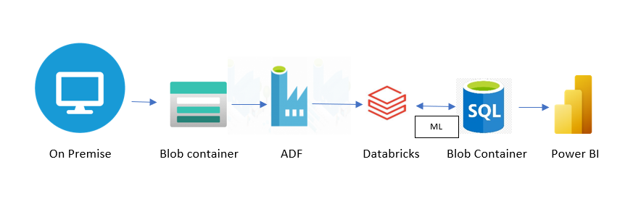
Architecture

Slide 5
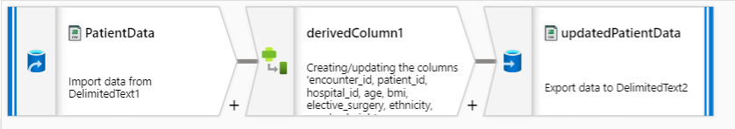
ADF pipeline :
Data imported is cleaned in ADF using pipelines and stored as Updated patient data into blob storage container.

Slide 6
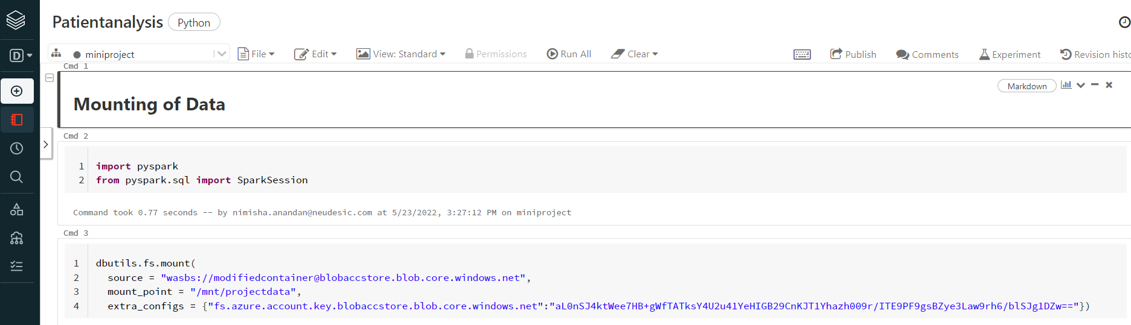
Databricks :

Slide 7
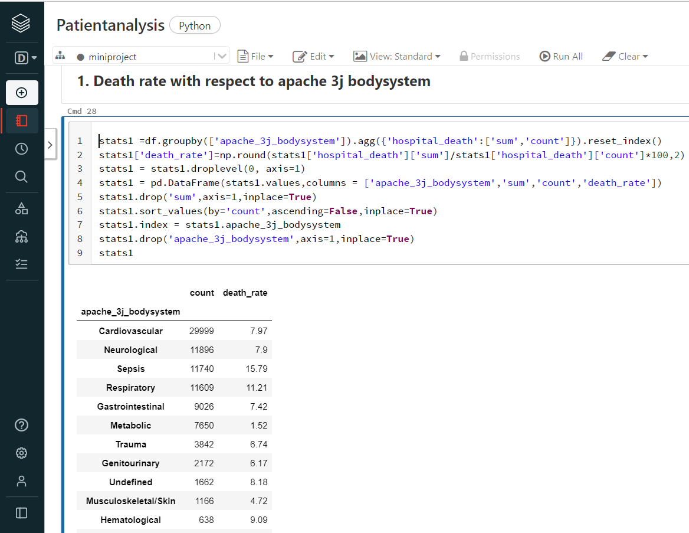
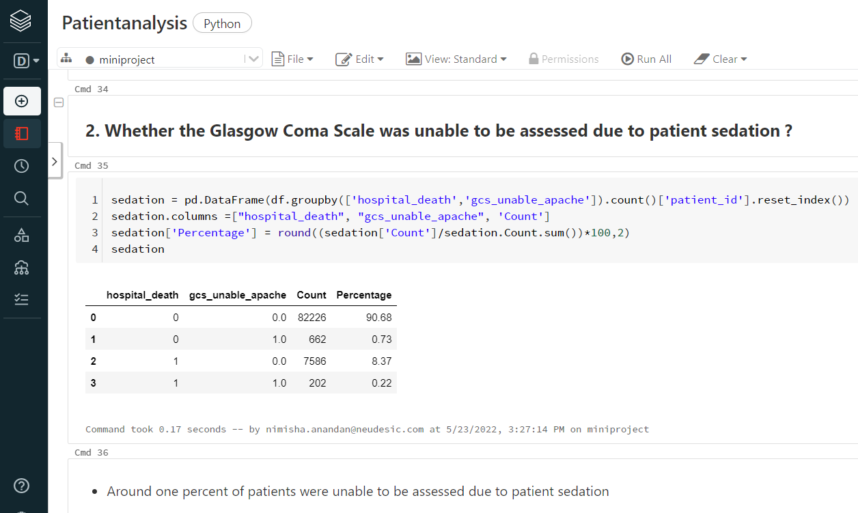
Databricks :

Slide 8
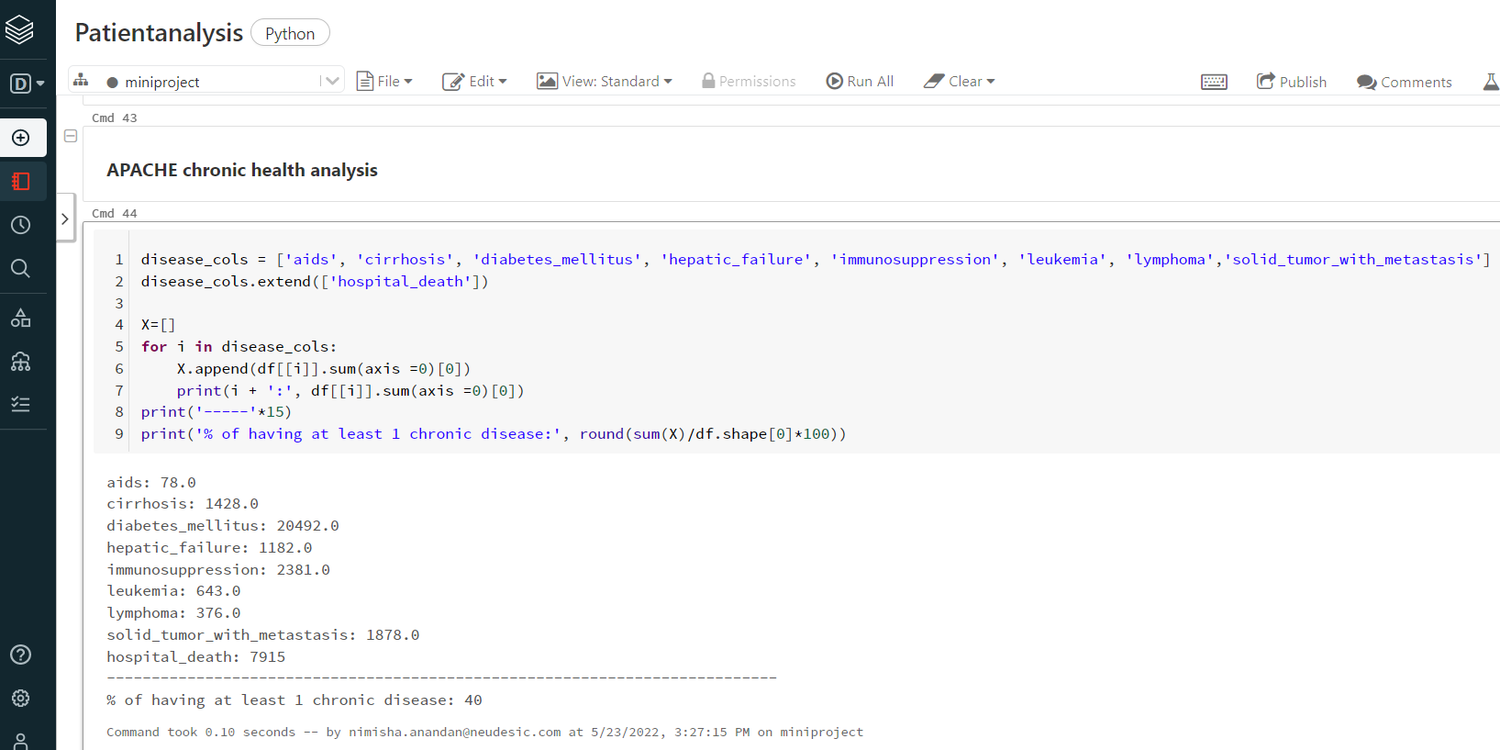
Databricks :

Slide 9
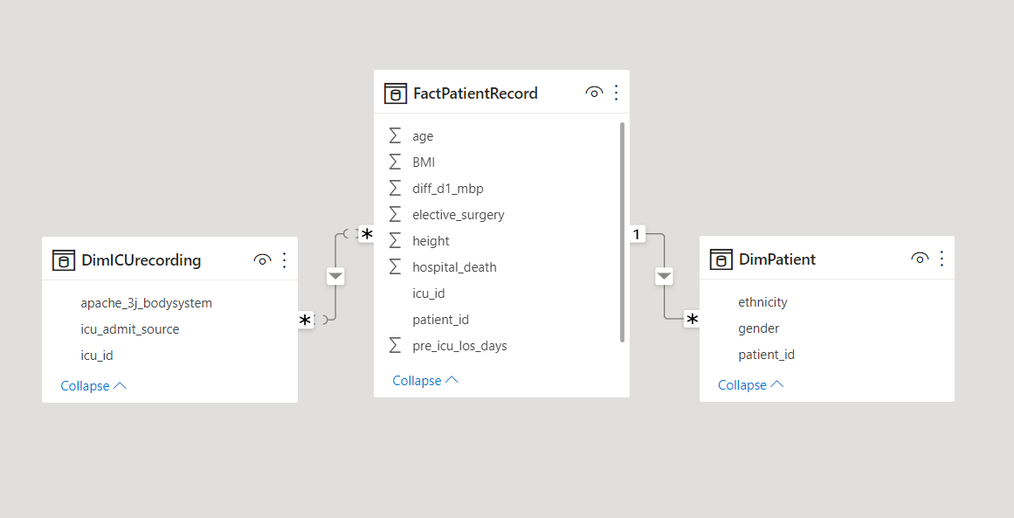
Power BI
Updated Patient data is split into fact and dimension table and uploaded to SQL DB. From SQL DB its mounted to Power BI.

Slide 10
POWER BI
Over to Power BI Demo

Slide 11
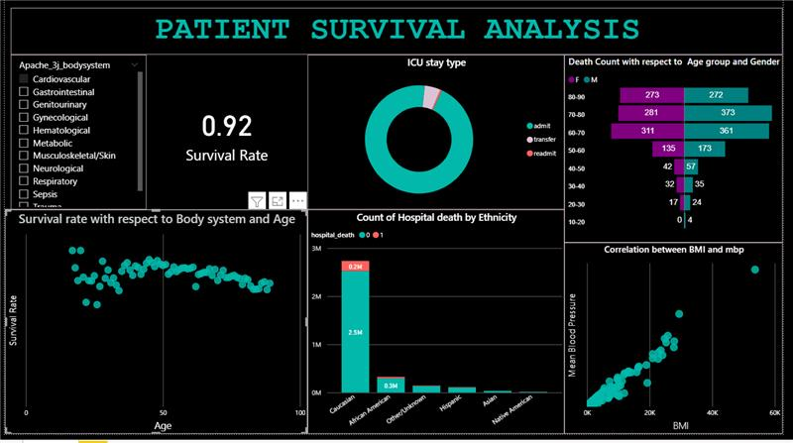
Power BI

Slide 12
Prediction of Patient Survival
Following ML algorithms were used :
Logistic Regression Model
Linear SVM Model
Decision Tree Classifier
Random Forest Classifier
Gradient Boosted - Tree Classifier
It is found that Gradient Boosted – Tree classifier best predicted the survival with 81 % accuracy.

Slide 13
Thank You

